Slide 1
Closed-Form Diffraction Modeling
Terry Bartlett, Zach Walker

Slide 2
Optical Modeling of DMD Diffraction
Ray tracing is not adequate for diffraction efficiency or contrast modeling
Generally scalar diffraction theory can be used for calculating diffraction efficiency
Relatively simple DMD model consisting of mirrors only
Incoherently integrate over wavelength and source extent
Reference: “Linear systems formulation of non-paraxial scalar diffraction theory” James E. Harvey, Proc. of SPIE Vol. 8122
Contrast modeling is much more complicated requiring more rigorous electromagnetic modeling (will not be covered here)
Requires very detailed models of pixel structure including dark thin film coatings and CMOS layout
Finite Difference Time Domain (FDTD) slices very complex 3D geometry into cells and rigorously solves Maxwell’s equations in time

Slide 3
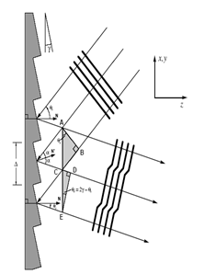
DMD Behaves Similar to a Blazed Diffraction Grating
Direction of reflected light at each diffraction order, m, given by the grating equation
where D is the pitch
Direction/separation of diffraction orders varies with mirror pitch and wavelength
Diffraction orders are fixed and do not separate/spread with mirror tilt
As wavelength increases, so does separation between diffraction orders
normal
M = +2
+1
0 order
-1
-2
D

Slide 4
Blaze Condition
Envelope determined
by pixel mirror shape
and tilt angle
N
N
N+1
N-1
N+1
N-1
0 order
0 order
Tilt angle 1
Tilt angle 2
D
D
Blaze condition:
Nearly all energy in one
diffraction order
Off-blaze condition:
Energy spread between
multiple orders

Slide 5
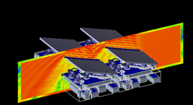
Diffraction Modeling of Broadband Extended Sources
wavelengths
Display
screen
Projection lens
aperture removes
energy outside of
F/number cone
Integrate fields
incoherently over
wavelength and
position
Pupil positions
Large number of plane waves launched from
multiple directions within illumination pupil
Diffraction model calculates far-field
for each incident plane wave

Slide 6
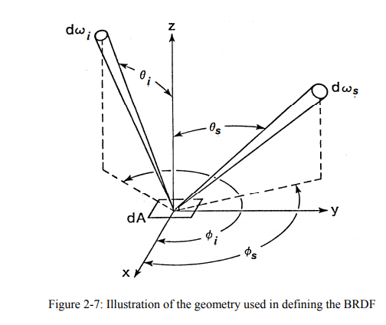
DMD diffraction can be treated as a surface scatterer with Bidirectional Scatter Distribution Function (BSDF)
Typical scattering surfaces (isotropic) can be characterized by in-plane BSDF because scattering properties do not change with angle phi. DMD diffraction is discrete and BSDF functions are typically described by continuous functions.
The DMD does NOT behave like this since the scattering properties change with phi.
In spite of this we can use Harvey’s non-paraxial diffraction theory model to describe scatter from the DMD.

Slide 7
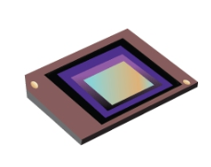










Geometry
$$\text{β}$$
$\text{α}\text{2}\text{+}\text{β}$²=1
Far Field
(direction cosine space)
Fractional power in each order is $\text{P}\text{(}\text{α}\text{m}\text{, }\text{β}\text{n}\text{)}$
Mirror normal
direction
order (3,1)
$$\text{α}$$
$$\text{β}\text{tilt}$$
$$\text{α}\text{tilt}$$
Discrete diffraction
orders (m,n)
$$\text{β}$$
Incident ray
(plane wave)
direction
$$\text{β}\text{i}$$
$$\text{α}\text{i}$$
Envelope
determined
by mirror shape
$$\text{α}$$

Slide 8
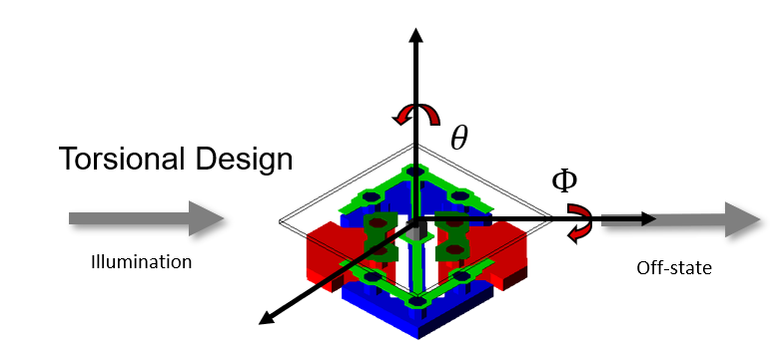
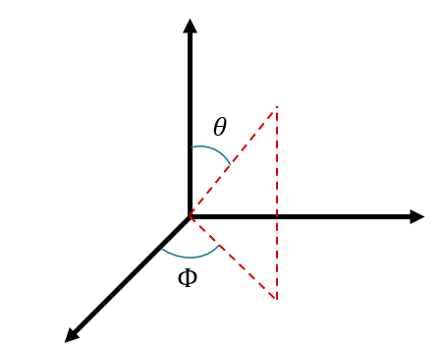
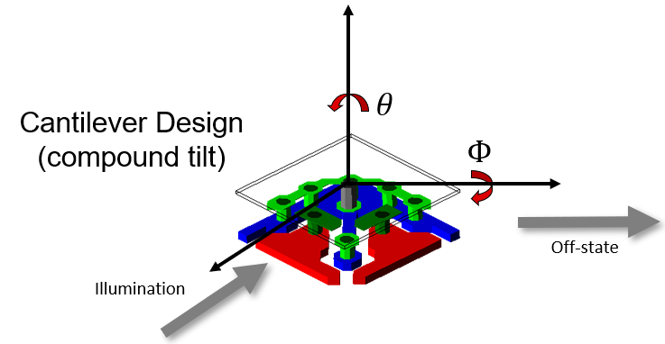








Coordinate System
$θtilt$ = 12º
$θillum angle$ = 24º
$Φillum direction$ = -45º
Spherical Coordinate System
$θtilt$ = 17º
$θillum angle$ = 34º
$Φillum direction$ = -90º
$$θ axis −tilt and illumination angle$$
$$Φ axis −illumination direction$$

Slide 9

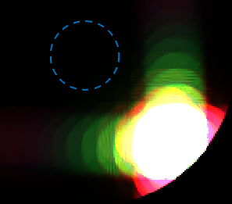

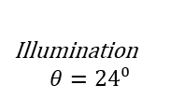




Coordinate System-Torsional
Incoming Light
$$On: Tilt θ=12⁰$$
$$Off: θ=−{12}^{0}$$
$Φ=−45⁰$
Illumination
$$θ=24⁰$$
Hinge Axis
Off-State Light
Illumination
$$Φ=−45⁰$$
ON
Mirror On State
θ = 12⁰, Φ = -45⁰
Illumination
θ = 24⁰, Φ = -45⁰
Mirror Off State
θ = -12⁰, Φ = -45⁰
Illumination
θ = 24⁰, Φ = -45⁰
FLAT
Pupil Diagrams
OFF

Slide 10
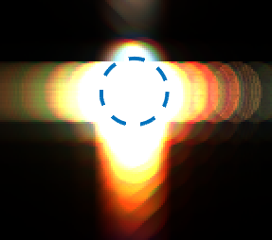
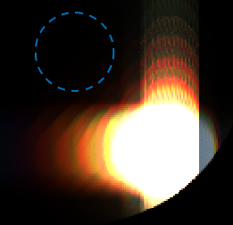





Coordinate System – Cantilever Design - TRP
Tilt
Roll
$$On: Tilt θ=17⁰$$
$$Off θ=−{17}^{0}$$
$Φ=−90⁰$
Illumination
$$θ=34⁰$$
Off-State Light
Incoming Light
ON
FLAT
Illumination
$$Φ=−90⁰$$
Mirror Off State
θ = -17⁰, Φ = -90⁰
Illumination
θ = 34⁰, Φ = -90⁰
Mirror On State
θ = 17⁰, Φ = -90⁰
Illumination
θ = 34⁰, Φ = -90⁰
Pupil Diagram
OFF

Slide 11
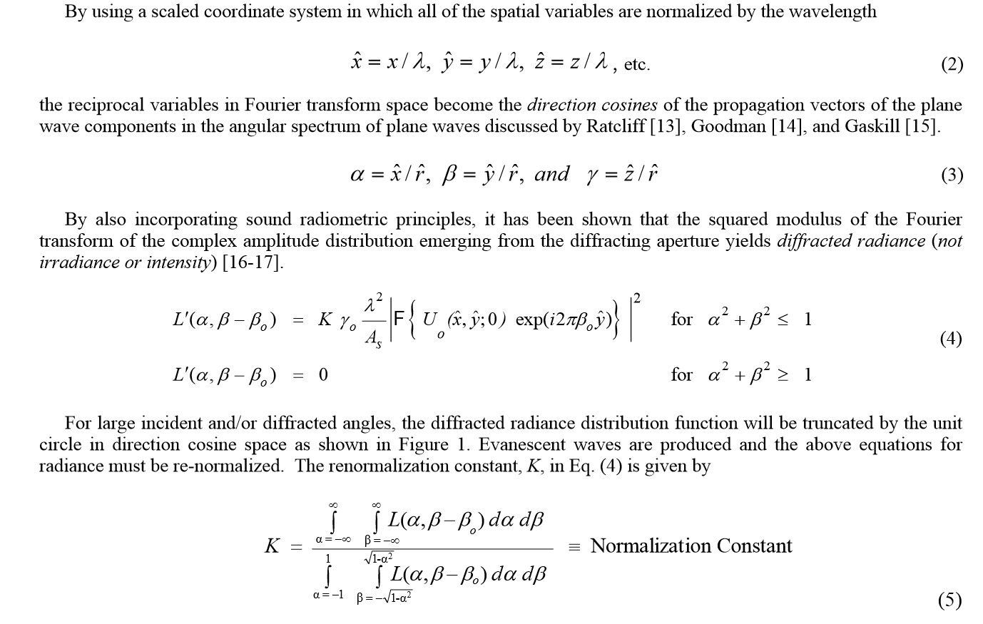
Start with Non-Paraxial Scalar Diffraction Theory
Reference:
“Linear systems formulation of non-paraxial scalar diffraction theory”
James E. Harvey, Proc. of SPIE Vol. 8122

Slide 12
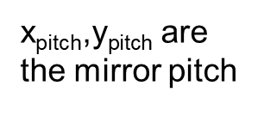
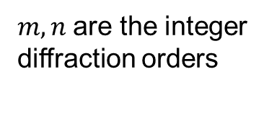

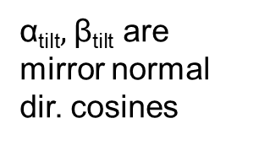


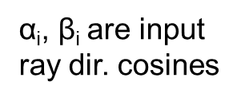
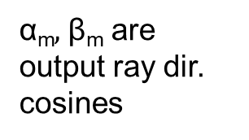


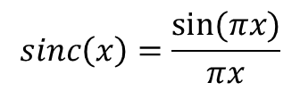
Closed-Form Diffraction Equations (on state)
For each output diffraction order (m, n), an output ray (plane wave)
appears at these direction cosine directions:
$$\text{α}\text{m}=\text{α}\text{i} \text{+} m λ\text{/}\text{x}\text{pitch}$$
$$\text{β}n \text{= }\text{β}\text{i}+nλ\text{/}\text{y}\text{pitch}$$
These diffraction orders only exist within the unit circle:
$\text{α}\text{m}\text{2}\text{+}\text{β}\text{n}$²<1
where:
$\text{α}\text{m},$ $\text{β}\text{m}$are output ray dir. cosines
$\text{α}\text{tilt},$ $\text{β}\text{tilt}$ are mirror normal dir. cosines
$\text{x}\text{width}\text{, }\text{y}\text{width}$ are the
mirror widths
$$sinc\left(x\right)=\frac{sin⁡(πx)}{πx}$$
$\text{α}\text{i}\text{,} \text{β}\text{i}$ are input ray dir. cosines
$\text{x}\text{pitch}\text{,}\text{y}\text{pitch}$ are
the mirror pitch
$m,n$are the integer
diffraction orders

Slide 13
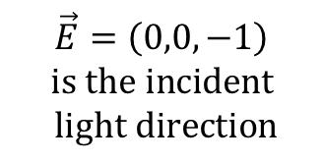
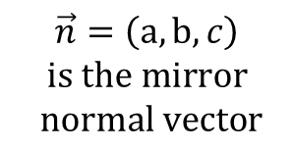

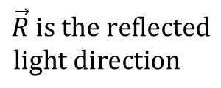
Closed-Form Diffraction Equations (on state): Reflected ray direction
$\vec{R}=\vec{E}$-2($\vec{E}∗\vec{n}$)$\vec{n}$=(-2ac, -2$bc,2c2−1$)
$$\text{c}=\sqrt{\text{1−}\text{a}2−b2}$$
Note that a mirror with normal (-z) illumination and normal
direction cosines a, b will have reflected direction cosines of 2ca and 2cb!
$$\vec{R} is the reflected$$
$$light direction$$
$$\vec{E}=\left(0,0,−1\right)$$
$$is the incident$$
$$light direction$$
$$\vec{n}=\left(\text{a},\text{b},c\right)$$
$$is the mirror$$
$$normal vector$$
where:

Slide 14
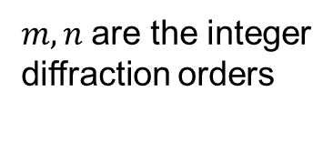


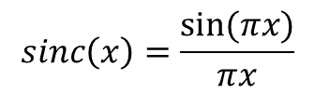

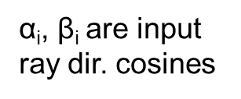

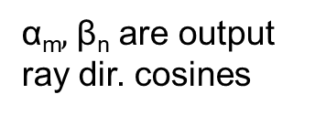

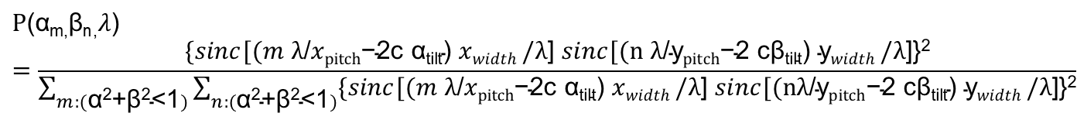

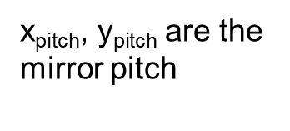

Closed-Form Diffraction Equations (on state): Large Tilt Angle Correction Term
For
$$\text{α}\text{m}=\text{α}\text{i}\text{+}m λ\text{/}\text{x}\text{pitch}$$
and
$$\text{β}n\text{=}\text{β}\text{i}+nλ\text{/}\text{y}\text{pitch}$$
and
$\text{α}\text{2}\text{+}\text{β}$²<1:
$$\text{P}\text{(}\text{α}\text{m}\text{,}\text{β}\text{n}\text{,}λ\text{)}=\frac{\{sinc[(m λ\text{/}x\text{pitch}\text{−2}\text{c} \text{α}\text{tilt}\text{) }xwidth /λ\text{] }sinc[(\text{n} λ\text{/}\text{y}\text{pitch}\text{−2} \text{c}\text{β}\text{tilt}\text{) }\text{y}width /λ\text{]\}}\text{2}}{\sum_{m:(\text{α}\text{2}\text{+}\text{β}\text{2}\text{<1})}{\sum_{n:(\text{α}\text{2}\text{+}\text{β}\text{2}\text{<1})}{\{sinc[(m λ\text{/}x\text{pitch}\text{−2}\text{c} \text{α}\text{tilt}\text{) }xwidth /λ\text{] }sinc[(\text{n}λ\text{/}\text{y}\text{pitch}\text{−2} \text{c}\text{β}\text{tilt}\text{) }\text{y}width /λ\text{]\}}\text{2}}}}$$
Else:
$$\text{P}\text{(}\text{α}\text{m}\text{,}\text{β}\text{n}\text{,}λ\text{)} \text{=0}$$
$$\text{c}=\sqrt{\text{1−}\text{α}\text{tilt}2−\text{β}\text{tilt}2}$$
$$sinc\left(x\right)=\frac{sin⁡(πx)}{πx}$$
where:
$\text{α}\text{m},$ $\text{β}\text{n}$are output ray dir. cosines
$\text{α}\text{tilt},$ $\text{β}\text{tilt}$ are mirror normal dir. cosines
$\text{x}\text{width}\text{, }\text{y}\text{width}$ are the
mirror width
$\text{x}\text{pitch}\text{, }\text{y}\text{pitch}$ are the
mirror pitch
$m,n$are the integer
diffraction orders
$\text{α}\text{i}\text{,} \text{β}\text{i}$ are input ray dir. cosines

Slide 15
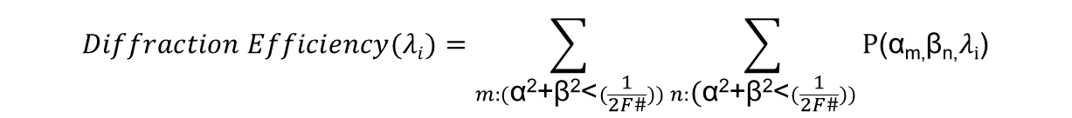


Diffraction Efficiency Obtained by Summing
For each wavelength the diffraction efficiency within the F/number is given by:
$$Diffraction Efficiency(λi)=\sum_{m:(\text{α}\text{2}\text{+}\text{β}\text{2}\text{<}(\frac{1}{2F\#}))}{\sum_{n:\text{(}\text{α}\text{2}\text{+}\text{β}\text{2}\text{<}(\frac{1}{2F\#}))}{\text{P}\text{(}\text{α}\text{m}\text{,}\text{β}\text{n}\text{,}λ\text{i}\text{)}}}$$
$$Photopic Efficiency=\frac{\sum_{λi}{S\left(λi \right) Phot\left(λi\right)D iffraction Efficiency(λi)}}{\sum_{λi}{S\left(λi \right) Phot(λi)}}$$
Where:
$$S\left(λi \right)=source spectrum$$
$$Phot \left(λi \right)=photopic curve$$

Slide 16
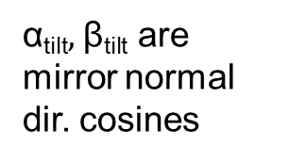

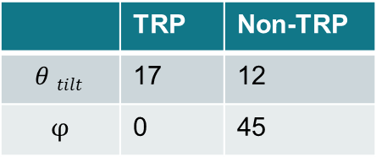

TRP or non-TRP?
Mirror normal
direction
$\text{α}\text{tilt}$=sin($θ tilt$)cos($φ$)
$$\text{β}\text{tilt}$$
$\text{β}\text{tilt}$=sin($θ tilt$)sin($φ$)
$$\text{α}\text{tilt}$$
 | TRP | Non-TRP
$$θ tilt$$ | 17 | 12
$$φ$$ | 0 | 45
$\text{α}\text{tilt},$ $\text{β}\text{tilt}$ are mirror normal dir. cosines

